Slide 1


POTTY SPOTTER The Toilet Finder
Debug Dynasty
N. V. HEMANTH KUMAR VEMULAKONDA TARUN
K. V. K. K. SAI PRANEETH K. HRUSHIKESH

Slide 2




The team
N. V. HEMANTH KUMAR VEMULAKONDA TARUN
K. V. S. K. SAI PRANEETH K. HRUSHIKESH
This project would not be possible without them. Working on this project was great exposure for all of us and we had a wonderful and stimulating experience.

Slide 3
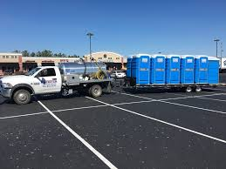
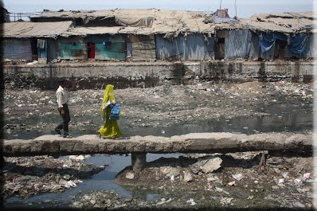
Find any difference ?? There is a lot to do in Sanitation, which is not something that is to be done, but lot to be maintained. Everyone wants to see their country clean and green but, are we really doing something towards it.

Slide 4
ABSTRACT
Many a times while travelling, people get stuck in the middle of nowhere and want to use a toilet. Our project aims at eliminating this problem by searching and showing the nearest Toilet to the user.
We will develop an android app which, will suggest the nearest Toilets using Google Maps SDK, Google Places and Google Distance Matrix APIs, and will help the user to navigate to the selected Toilet.
The user has the option of applying various filters, such as a rating, pricing (free/paid) and various types of toilets (public, commercial like restaurants, malls, gas stations and bars).
This will help users to reach a Toilet on time even in an unknown location or when they are stuck with no help around. The application is light weight and doesn’t require much space and gives accurate output.

Slide 5
WHY IT HASN’T BEEN IMPLEMENTED ?
The problem of finding public toilets has never really been addressed due to the following reasons:
The public have a stigma towards to public toilets due to their unhygienic nature. Our project seeks to address that by having users themselves rate the toilets. This can serve as an incentive to the local municipal authorities to clean the toilets.
People resort to public urination or defecation because they can get away with it. This app seeks to eliminate that as an option, and proposes the use of public toilets as an alternative.

Slide 6
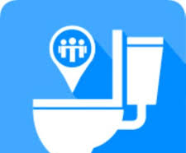

FEATURES BEING IMPLEMENTED
We seek to implement the following primary features to provide a means of addressing the problem touched upon above:
Provide a feature that allows the user to query for the location of the nearest public toilet, restroom or washroom depending upon their requirement. The app determines the nearest toilet and also directs the user to it. The app allows filtering the search on various parameters, such as rating, history, personal preference and time of day.
Provide a feature that allows to users to rate the toilet/washroom they’ve used. This rating will be of great help to other people in the future, and will also adjust the searching algorithm by including rating as a factor.

Slide 7


Provide a feature that allows people to incriminate others who are found urinating or defecating in public, by taking a photo of them. This photo is automatically tagged with the location, and is forwarded to the nearest police station or police outpost, whose location is also ascertained by the app. This serves to promote citizen behavior and also assists the law enforcement agencies in upholding the integrity of the nation.
Provide a feature, whereby a user can manually enter a new toilet’s location, one which the app was unable to find through its scans. This allows people to manually find some toilets which would have otherwise been undiscovered.

Slide 8
PLANNED FEATURES & FUTURE IMPROVEMENTS
The following features can be added to the app to make it more dexterous:
Secure a partnership with the local municipal authorities. An alert is sent out daily to clean the toilets. An alert is also sent out when the rating falls below a certain number of stars (say 4) so the authorities can take the necessary steps.
Areas where this app is frequently requested can be identified, and a report can be set out the local municipalities to facilitate the installation of new toilets in those areas.

Slide 9
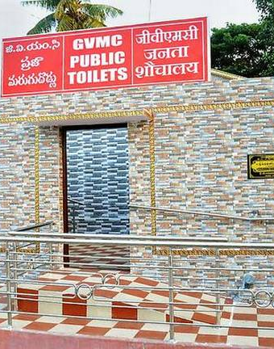
APPROACH
Problem 1: Nearest Public Toilet
Our approach to a solution for this problem is broken down into the following sequence of actions:
When the user feels the need to use the toilet, they open the app.
The app prompts them to enable access to the GPS location tracking system so as to ascertain the current location of the user. A working internet connection is mandated for this step.
Upon registering the user’s location, the app will scan through a preloaded database for the nearest public toilet, or any other washroom/toilet made available to the public, such as shopping malls, petrol bunks, etc.

Slide 10
The database is either hardcoded, or the app performs a onetime download of the local map, and nearby facilities, identifies toilets or restrooms nearby and stores them in the database.
Once the nearest washroom is identified, if it is not highly rated, another washroom is also searched for, this time, with it being of good rating (>4 stars for instance). Both results are shown to the user, who can pick whichever one they are more comfortable with, along with the usage fee (if any).
Once the location of the chosen washroom has been ascertained, the app automatically switches to Google Maps navigation system to direct the user to the destination.

Slide 11
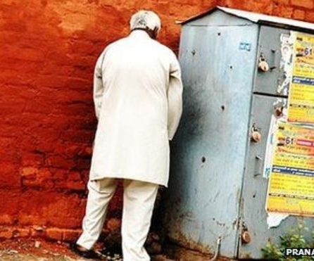
Problem 3: Identifying and reporting defaulters
Our approach to a solution for this problem is broken down into the following sequence of actions:
Any user of the app can take a photo of a person violating the rules by openly urinating or defecating, and upload it to the app.
This photo is then automatically transferred to the nearest police station or outpost where they can take the necessary steps.
The nearest police station is ascertained with the help of the database, which also scans the locality for police stations in addition to restrooms.

Slide 12
CONTRIBUTIONS
N.V. HEMANTH KUMAR
Coordinated the team’s efforts.
Jointly Responsible for the integration of Google Maps SDK, Places and Directions APIs into the project.
Responsible for the storage and retrieval of location data.
V. Tarun
Jointly Responsible for the integration of Google Maps SDK, Places and Directions APIs into the project.
Prepared the Power Point Presentation for the project.
K.V.K.K SAI PRANEETH
Partly responsible for the design of UI.
Specifically the ADD_TOILET activity and FILTERS.
K. HRUSHIKESH
Partly responsible for the design of UI.
Specifically the MAIN_ACTIVITY and REPORT_ACTIVITY

Slide 13
CONCLUSION
The malady of public urination and defecation spreads across the nation, and even across the world.
To address this issue, we have come up with the idea to provide and easily accessible interfaces to the populace to use public toilets.
We empower the users to choose toilets of their convenience and preference as well as take the initiative to add a new henceforth unknown toilet into the database for the benefit of all.

Slide 14
THANK YOU

